Slide 1
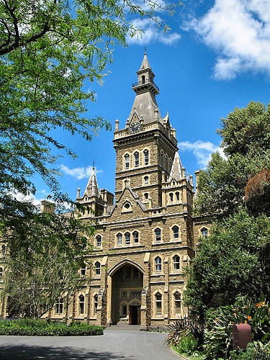
Financing for Energy Performance Contracts in Nevada
February 6, 2014
Henderson, Nevada
Presented by:
Dan Dowell
ABM Facility Services

Slide 2
Performance Contracts
Separate Statutes for Local Governments and State Agencies
Local Government
Statute – NRS 332
A performance contract may be financed through a person other than the qualified service company
Savings must be greater than costs
Contract Period
Up to a 15 year term
Payments begin after installation is complete
Must include a non-appropriations clause
Financial Guarantee
A performance contract must include appropriate financial mechanisms determined to be necessary to the city our county treasurer to ensure that the savings are achieved

Slide 3
Performance Contracts
State Agencies
Statute – NRS 333
May be structured as a true performance contract, under which annual saving must meet or exceed the total annual contract payments, including any financing charges
Alternatively, it may be structured as a shared-savings contract including provisions agreed upon between the agency and ESCO regarding rate of payments based on savings

Slide 4
Performance Contracts
State Agencies
State may grant a security interest in any property subject to the installment-purchase or lease-purchase contract
State may offer Certificates of Participation (COPs)
Statute authorizes the State to enter into other beneficial agreements, including contracts for professional services (legal, etc.), trust indentures, paying agent agreements, insurance, etc.
Approvals Required
For State Agencies - State Board of Examiners
For Higher Education - Board of Regents of the University of Nevada

Slide 5
Local Government Financing
Funding Options
Could include a combination of:
Operational Savings
Capital Funds
Grants, Incentives, Rebates
Existing Bond Proceeds
Other Capital Contribution
Financing Structures
General Obligation Bond – backed by the full faith and credit of a governmental entity
Revenue Bond– backed by a pledge of specific revenues
Medium Term Obligation Bond
Limited to 10 years (depending on asset useful life)
Installment Purchase Agreement

Slide 6
Financing Options
Installment Purchase Agreement
Overview of an Installment Purchase Agreement
2 party transaction – local government and funding source
Annual appropriation obligation
Not technically debt, but . . .
Source of payments
Anticipated from savings, but technically from any lawfully available funds
Payment timing
Installation period, repayment period
Escrow funding
Local government issue
Prepayment options
Timing
Low cost of issuance but typically used under $4 to $5 Million

Slide 7
Local Government Financing
Installment Purchase Agreement
Local Government Approval Process:
Local Governing Body (School Board, City Council, etc.)
At least 2 meetings are needed – preliminary and final
Public hearing required
Financing must be approved by 2/3rds majority of the governing body
Must identify sources of revenues that will be used to pay back the financing (i.e. guaranteed savings)
If the term is longer than 10 years, the Board must make a statement in the resolution comparing the cost of this financing method against other available methods of financing (General Obligation bonds, revenue bonds, etc.)

Slide 8
Local Government Financing
Installment Purchase Agreement
Local Government Approval Process:
Local Governing Body (cont.)
If this statement concludes that the costs of the installment purchase is more expensive that the other available method, the body must further make a statement explaining the reasons for choosing the installment purchased financing instead of a less expensive alternative.
If the term is longer than 10 years, the transaction must be approved by the local Debt Management Commission
Size of Project Will Dictate Term & Structure

Slide 9
Why Now?
Trends
Avg Age of School Buildings 60 Years
Cost of Capital – Cheapest Since Late 1940s/50s
Cities Seeing Increased Revenue First Time in Seven Years
Infrastructure Spending Best Way to Spur the Local Economy
Capital Revenues Down Since 2009 – When Will They Recover?
Determine Your Recovery Path

Slide 10
Progress to Date
At least 40 individual project financings completed since 1999
State/Local Governments Participants:
School Districts
Douglas County SD (2 Phases)
Lincoln County SD
Mineral County SD (QZABs)
Pershing County SD
Washoe County SD (6 Phases)
White Pine County SD
Cities
Carson City (2 Phases)
Henderson
Las Vegas (CREBs, QECBs)
Reno (3 Phases – QECBs, CREBs, etc.)

Slide 11
Progress to Date (cont.)
At least 40 individual project financings completed since 1999
State/Local Government Participants:
Counties
Pershing County
Washoe County (not financed)
Higher Education
UNLV (4 Phases)
Western Nevada Community College
State Agencies
Administration – Capitol Complexes
Corrections (Several Phases)
Health and Human Services
Other Entities
Las Vegas Valley Water District (CREBs)
Southern Nevada Water Authority (CREBs)

